Slide 1
Lecture 4: Biodiversity Scaling and the Species-Area (and time) Relationship

Slide 2
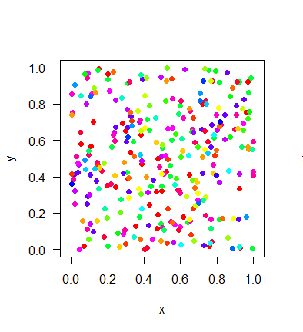
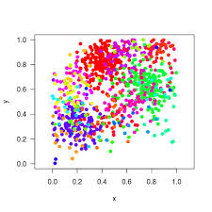
Scale-dependence is inevitable….
Species Richness
Sampling Effort
Species-Area Curve (many types)
Species Accumulation Curve
Rarefaction Curve

Slide 3
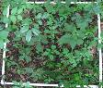
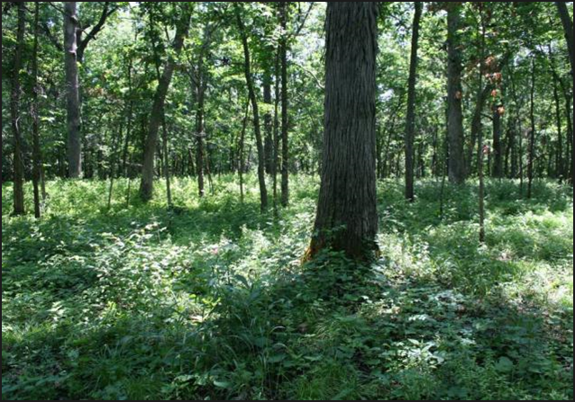
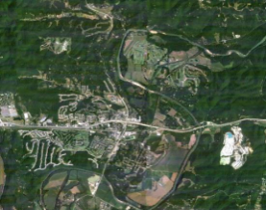
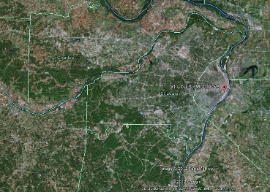
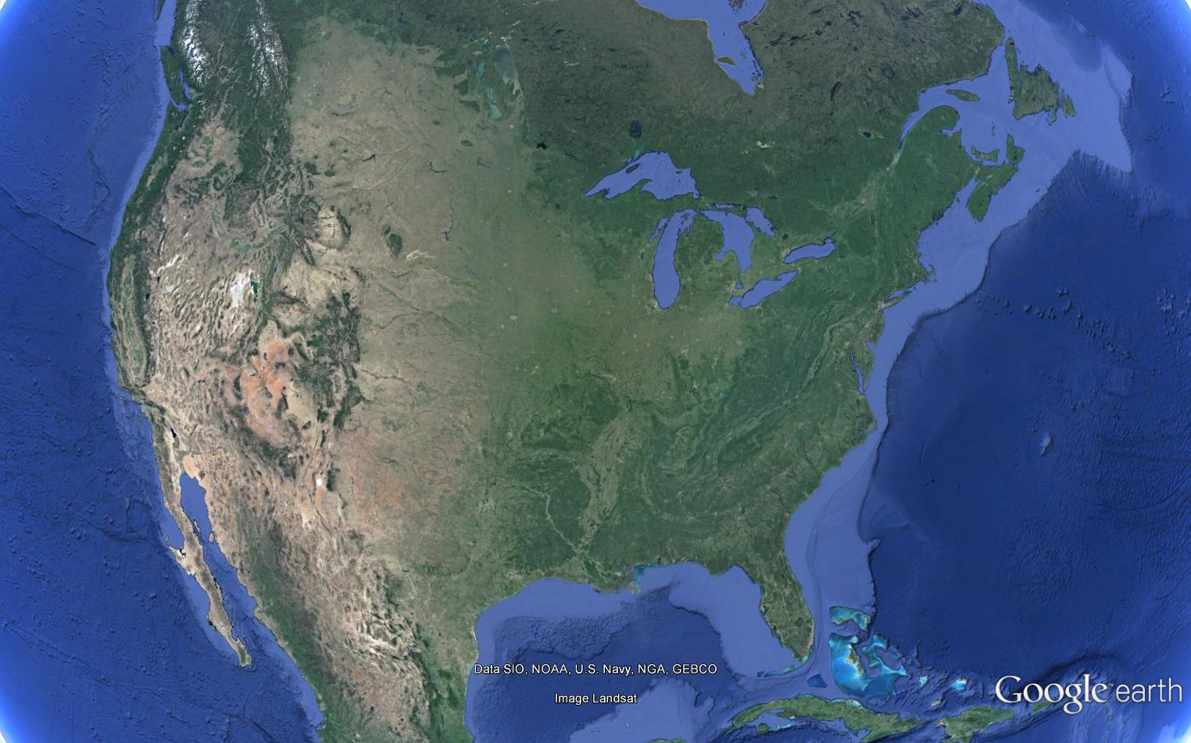
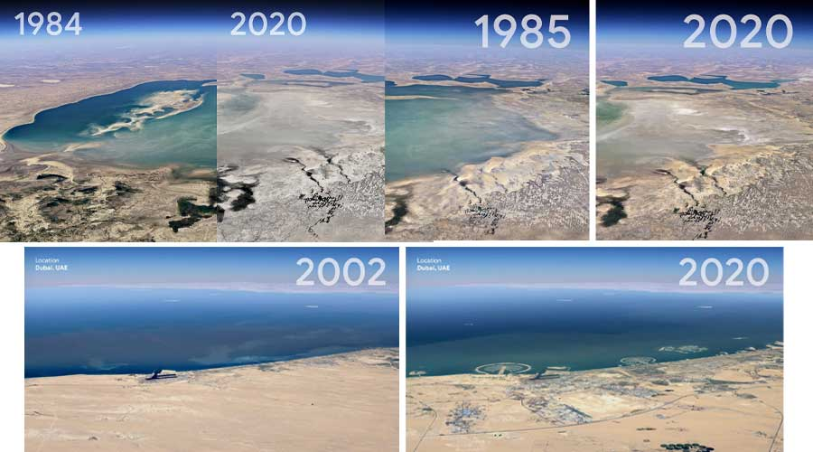
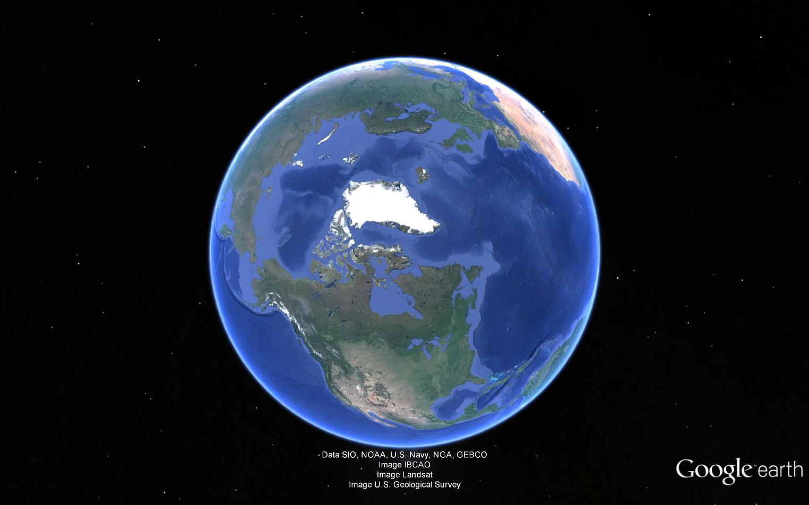
Biodiversity Scaling—Space And Time

Slide 4
Different Kinds of Species Area Relationships (SARs)
Island Species Area Relationship (ISAR)
Scheiner 2003

Slide 5
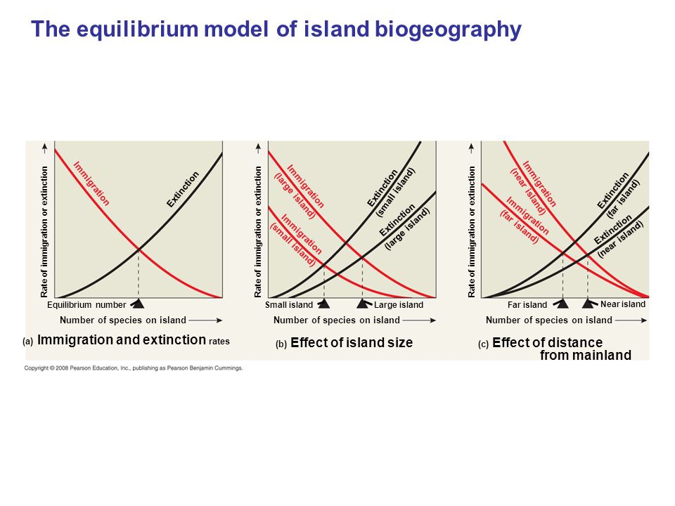
A Simple Model: Island Biogeography

Slide 6
Near Mainland
Far from Mainland
MacArthur and Wilson 1963

Slide 7
Different Kinds of Species Area Relationships (SARs)
Nested
Island Species Area Relationship (ISAR)
Scheiner 2003

Slide 8
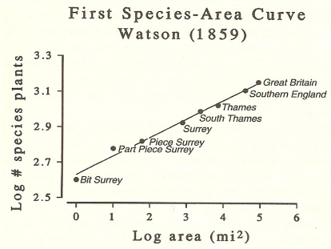
Preston 1960

Slide 9
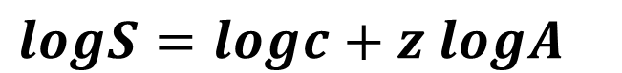
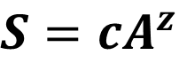
The classical Species Area Relationship (SAR) equation
$$S=cA^{z}$$
$$logS=logc{+ z logA}^{}$$
z (slope)
c (intercept)
Remember β-diversity

Slide 10
Mechanisms of the SAR
Sampling
Heterogeneity
Area ‘Per se’ (=metacommunity processes)
Connor and McCoy 1979

Slide 11
Variation in the shape of the SAR
Z (slope of the SAR)
Z (slope of the SAR)
Drakare et al. 2006

Slide 12
Heterogeneity and the SAR
Kallimanis et al. 2008

Slide 13
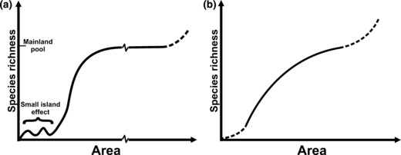
The SAR across scales (‘Triphasic’)

Slide 14
SAR principles can be used to predict extinctions

Slide 15
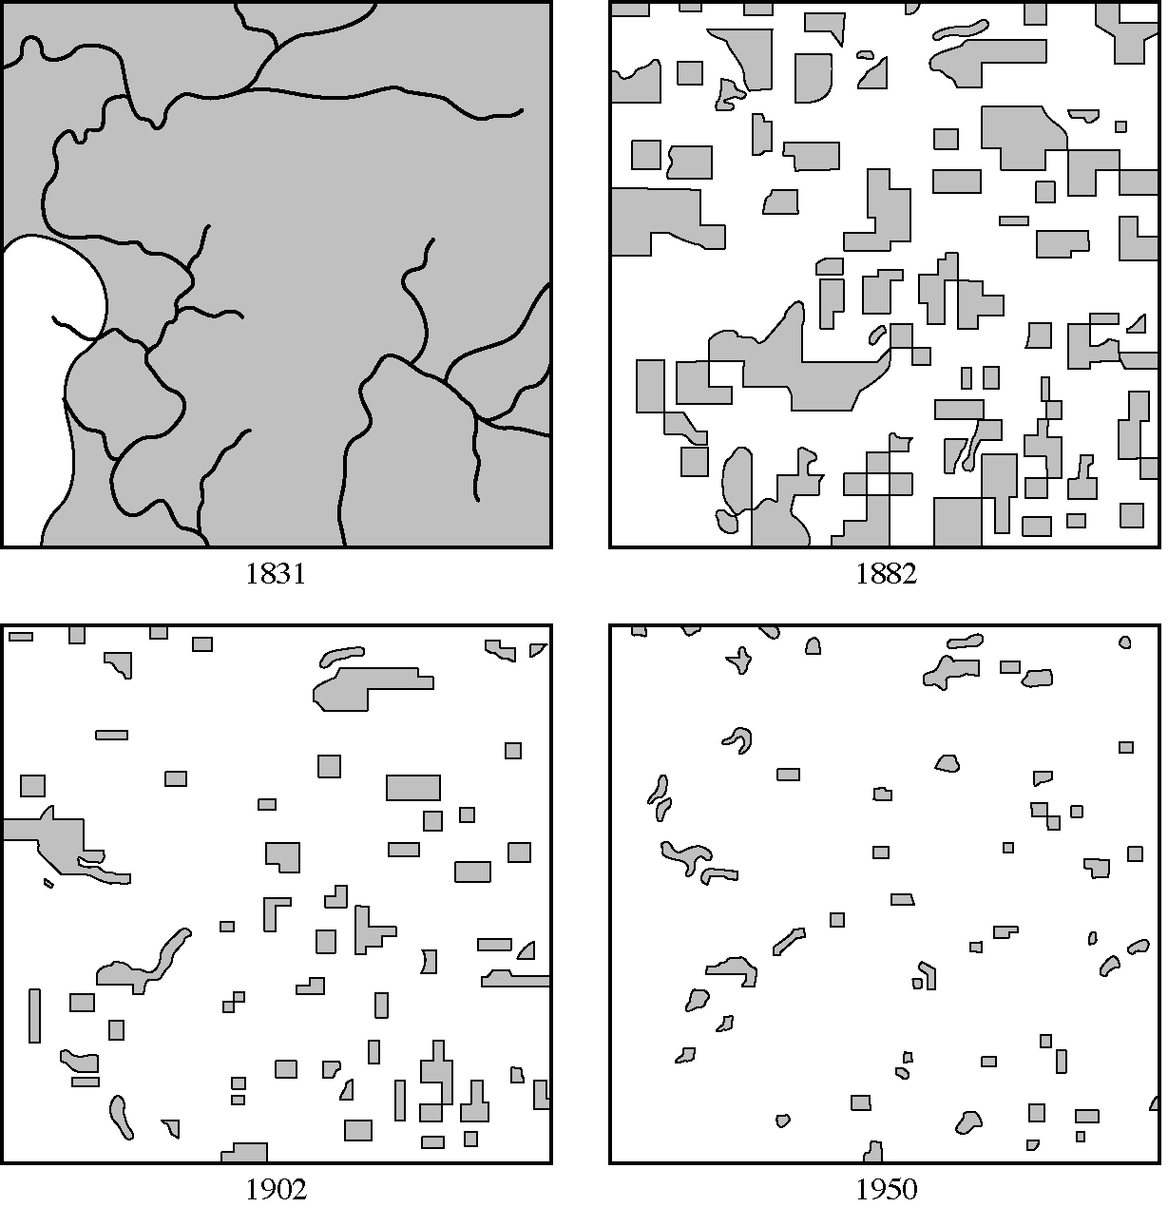

From MacArthur and Wilson 1967

Slide 16
Island biogeography and extinctions
Koh and Ghazoul 2010

Slide 17
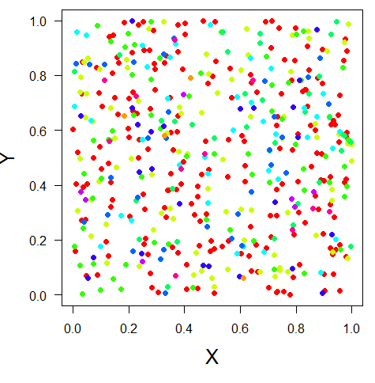
Any measure of diversity only captures part of the picture
α, richness, evenness, diversity entropy
β, similarity, distance decay
γ, SAR, EAR, etc
The only way we can ‘control’ this is when we make unrealistic assumptions
-i.e., a community has an ‘end’ and an ‘asymptote’

Slide 18
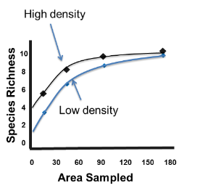
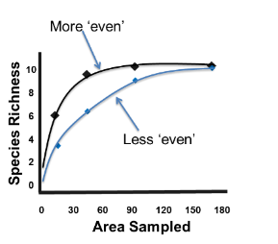
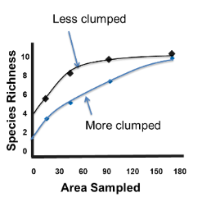
Species accumulation with scale will be non-parallel when the abundance and spatial distribution of species is altered—altering N, SAD, or aggregation
The density of individuals (N)
The relative abundance of individuals (SAD)
The spatial aggregation (clumping) among
individuals

Slide 19
Sampling and Scale
(more/fewer individuals)
Degraded Community
Pristine Community
Small Effect
Large effect
10
Species Richness
8
6
4
2
0
0 30 60 90 120 150 180
Area Sampled
Chase and Knight 2013 Ecology Letters

Slide 20
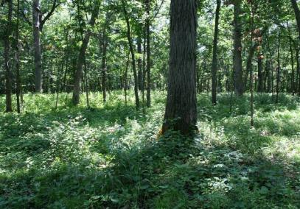
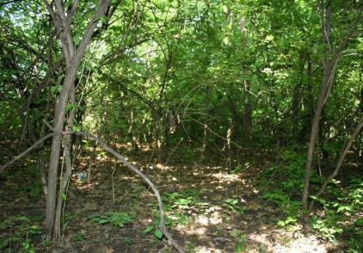
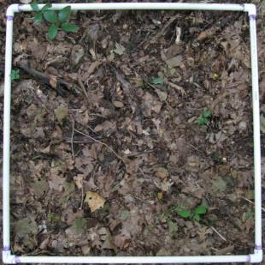
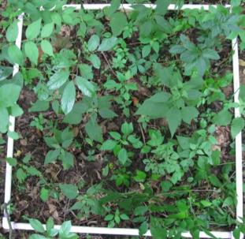
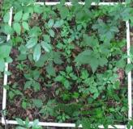

Scale-dependence of invasive species impacts
2.0
R²=0.995, P<0.001
R²=0.978, P=0.001
1.5
Log(Species Richness)
1.0
Uninvaded
Invaded
0.5
0
1
2
3
Log(Area)

Slide 21
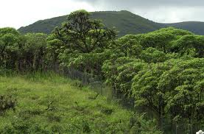
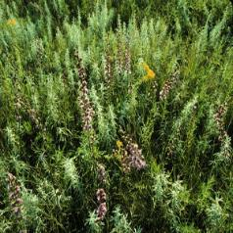
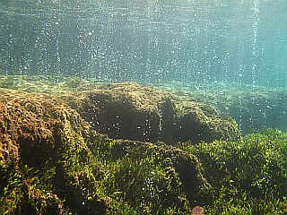
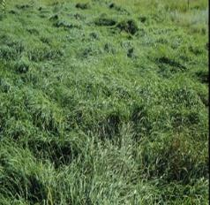
What if drivers are not neutral?
-More (or less) than ‘more individuals’
Some Examples…
Goat Exclosure
N Fertilizer
Increased CO₂/acidification

Slide 22
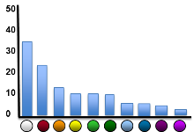
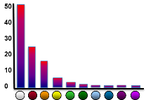
Habitat Loss Often Disproportionately Reduces Rare Species
More Even Community
Less Even Community
Small Effect
Large effect
10
Species Richness
8
6
4
2
0
Chase and Knight 2013
Ecology Letters
0 30 60 90 120 150 180
Area Sampled

Slide 23
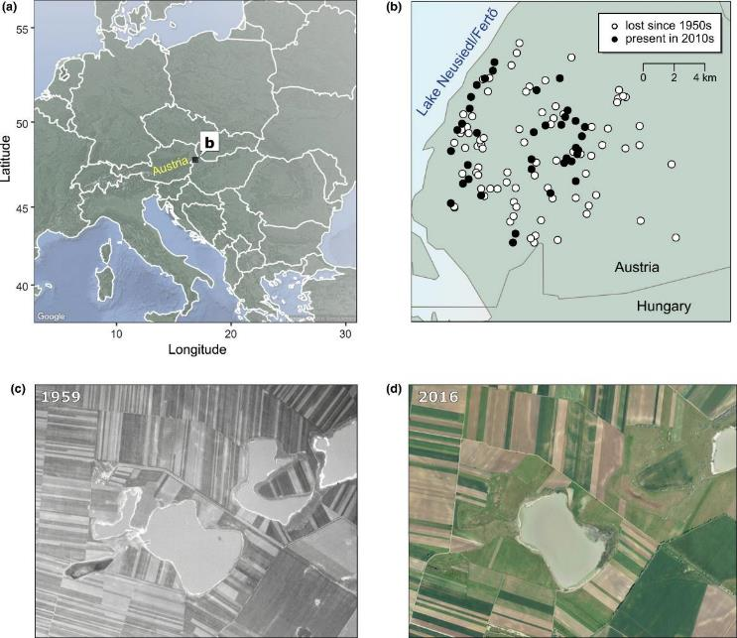
Horvath et al. 2019

Slide 24
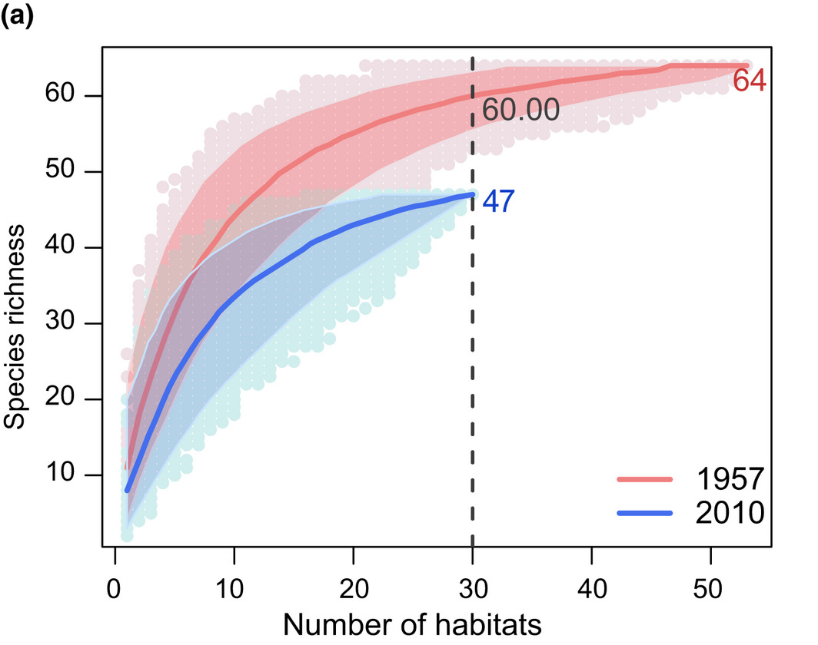
Horvath et al. 2019

Slide 25
Altering N, SAD, or aggregation----or S
Species Richness
Species Richness
Change SAD
Change S
Change SAD
No Change S
A or N
A or N
S differs for different reasons
Species Richness
Species Richness
No Change SAD
Change S
How can this happen?
A or N
A or N

Slide 26
What causes accumulation curves to cross?
How often does it happen?
Graham and Blake 2001

Slide 27
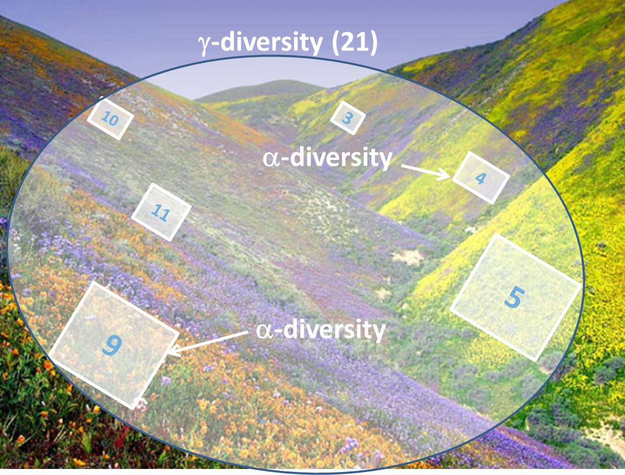
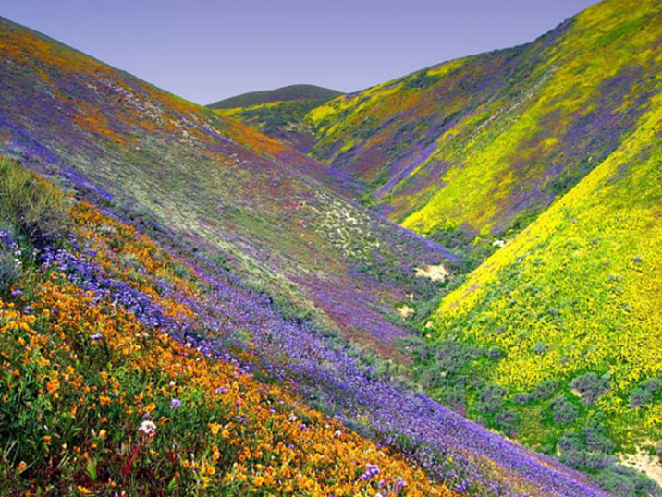
.. we already have a way to deal with scale…β-diversity
α β = γ
β = γ/α
γ-diversity (21)
10
3
α-diversity
= 21 / 7
= 3
4
11
5
9
α-diversity
β-diversity is a scalar from local (α) to regional (γ)

Slide 28
β-diversity is also complicated
γ-diversity
β-diversity
Diversity
α-diversity
Local Regional
Spatial Scale
Linearization of an inherently non-linear pattern
Shape determined by several distinct components that underlie SAC
Critically grain and extent dependent

Slide 29
Sample Grain and Extent drive β-diversity
Larger grain/extent
α-diversity
α-diversity
γ-diversity
γ-diversity
β
β
Number of Species
β
β
Area sampled

